Slide 1

Collaborative Writing
NANO-401 Materials & Nanoscience Capstone
Dr. Patterson

Slide 2
What this is about
Overview of the collaborative process
Strategies for writing successfully together
Tips for avoiding common pitfalls
Resources
Notes:
All of us participate in group writing. Benefits: multiple brains are better than one for generating ideas and getting a job done.
It is also stressful because of various opinions, different writing styles, and one final product may not please everyone.

Slide 3
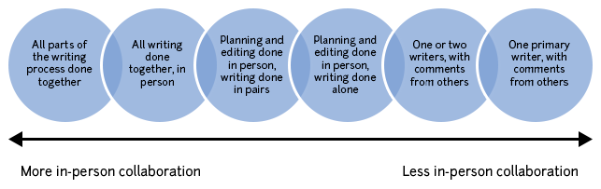
The spectrum of collaboration
Notes:
Group projects for classes should usually fall towards the middle to left side of this diagram, with group members contributing roughly equally. However, in collaborations on research projects, the level of involvement of the various group members may vary widely. The key to success in either case is to be clear about group member responsibilities and expectations and to give credit (authorship) to members who contribute an appropriate amount. It may be useful to credit each group member for his or her various contributions.

Slide 4

Overview of steps of the collaborative process
Pre-writing process
Planning and logistics
Research/data collection
Drafting/writing
Revising, editing, and proofreading
This Photo is licensed under CC BY-SA-NC

Slide 5
1. The Pre-Writing Process
Brainstorm
Formulate an argument
Imagine final product
Consider audience

Slide 6
2. Planning and Logistics
Assign parts
Determine format
Arrange meetings
Schedule it

Slide 7
3. Research and Data Collection
Sources
Process Info
What to Include
Interpret Findings
Data Collection
Present Info

Slide 8
4. Drafting and Writing
Meet and compose collaboratively.
Talk BEFORE starting.
Everyone has a different writing style!
Get ideas on paper before editing.
Notes:
Separately (each group member has his/her own portion of writing to do) Note that brainstorming the main points of your paper as a group is helpful, even if separate parts of the writing are assigned to individuals. You’ll want to be sure that everyone agrees on the central ideas. difficult for remote authors
time-consuming
ensures cohesive voice

Slide 9
5. Revising, Editing, and Proofreading
Merge
Proofread
Revise
Notes:
If your group has drafted parts of the document separately, merge your ideas together into a single document first, then focus on meshing the styles. The first concern is to create a coherent product with a logical flow of ideas. Then the stylistic differences of the individual portions must be smoothed over.
Revise the ideas and structure of the paper before worrying about smaller, sentence-level errors (like problems with punctuation, grammar, or word choice). Is the argument clear? Is the evidence presented in a logical order? Do the transitions connect the ideas effectively?
: Check for typos, spelling errors, punctuation problems, formatting issues, and grammatical mistakes. Reading the paper aloud is a very helpful strategy at this point.

Slide 10
Helpful collaborative writing strategies
Attitude
Start Early
Scheduling
Share Files
Separate tasks

Slide 11
1. Attitude counts for a lot
Enthusiasm keeps momentum
Respect keeps morale high
Notes:
of the group. Keep in mind that working in a group provides a unique opportunity to see how other people write; as you learn about their writing processes and strategies, you can reflect on your own. Working in a group inherently involves some level of negotiation, which will also facilitate your ability to skillfully work with others in the future.
to the table. Show your fellow writers respect by listening carefully, talking to share your ideas, showing up on time for meetings, sending out drafts on schedule, providing positive feedback, and taking responsibility for an appropriate share of the work.

Slide 12
2. Start early
Plenty of time is essential
Group work takes longer than individual work

Slide 13
3. Plan a strategy for scheduling
Consider: doodle, whenisgood, needtomeet
Submit drafts ahead of meetings
Set deadlines for drafts

Slide 14
4. Find a way to share files
Email attachments
Google documents
Dropbox
Common server space
Make back-up copies

Slide 15
5. Separate tasks
Assign giving feedback to group members
Assign concerns (grammar, organization, flow) to individual group members
Notes:
First, group members should provide general feedback and comments on content.
Only after revising and solidifying the main ideas and structure of the paper should you move on to editing and proofreading.

Slide 16
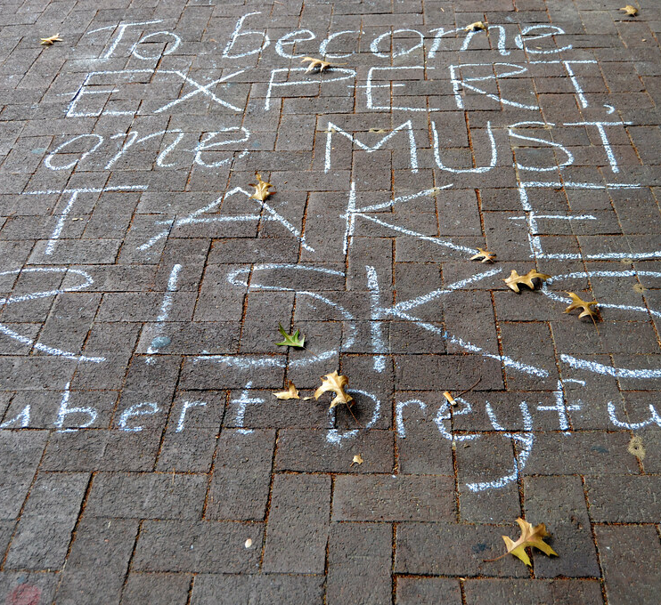
Your group project is an opportunity to become an expert on your topic!
This Photo by is licensed under CC BY-NC-ND

Slide 17
Pitfalls
Immediately dividing the writing into pieces
Procrastination
Being a solo group member
Waiting for other group members to do all of the work
Leaving all the end work to one person
Entirely negative critiques

Slide 18
1. Immediately dividing the writing into pieces
Write together!
Saves the difficulties of combining pieces
Creates a stronger, more cohesive document

Slide 19
2. Procrastination
You’ll need all the time you can get
more people to help with the work
multiple schedules to juggle
more opinions to seek

Slide 20
3. Being a solo group member
Not everyone enjoys working in groups.
Everyone must participate.
Always address your concerns with group members first.
You are learning about the project material and how to motivate others.

Slide 21
4. Waiting for other group members to do the work
You are leaving your grade in the control of others.
If you do not contribute, you are taking credit for work that you did not do.
Volunteer early for a portion of the work that you are interested in or feel you can manage.

Slide 22
5. Leaving all the end work to one person
The editor may not understand every idea another author wrote, leading to ambiguity/mistakes .
The editor must decipher and merge the original contributions under the time pressure.

Slide 23
6. Entirely negative critiques
highlight positive parts of the project
point out things that need work
add concrete, specific suggestions on how to proceed
“I had trouble understanding this paragraph because I couldn’t see how it tied back to our main argument.” vs “This paragraph is unclear and irrelevant.”

Slide 24

Several coaches worked together to create this advice and experienced the pros and the cons of the collaborative process.
The coaches have personally tested the various methods for sharing files and scheduling meetings described here, but do not advocate any service or site.

Slide 25

References
“Group Writing.” The Writing Center, https://writingcenter.unc.edu/tips-and-tools/group-writing. Accessed 20 Feb. 2020.
Cross, Geoffrey A. Collaboration and conflict: a contextual exploration of group writing and positive emphasis. Cresskill, New Jersey: Hampton Press, 1994.
Ede, Lisa and Andrea Lunsford. Singular Texts/Plural Authors: Perspectives on Collaborative Writing. Carbondale & Edwardsville: Southern Illinois University Press, 1990.
Speck, Bruce W. “Facilitating Students’ Collaborative Writing.” ASHE-ERIC Higher Education Report 28(6). San Francisco: Jossey-Bass A Wiley Company 2002.
This Photo is licensed under CC BY-SA-NC

